Slide 1
2026
Gender Pay Gap Reporting
Data is representative of a snapshot of April 2024-2025

Slide 2
Gender Pay Gap Report 2026 (2024- 2025 data)
To ensure our commitment to diversity stays at the heart of how we work, we must hold ourselves accountable and continue progressing toward closing all pay‑gap disparities. Making our progress visible — both inside and outside the firm — is essential. Measuring what matters ensures that culture and inclusion are not just about numbers, but about creating the conditions for everyone to perform, contribute, and succeed.
Understanding Gender Pay Statistics
It’s important to distinguish between gender pay reporting and equal pay. Equal pay ensures that men and women are paid the same for the same or equivalent work. Gender pay reporting, however, looks at the average pay of all men and women across the organisation and therefore reflects workforce composition and seniority distribution, not equal pay for equal work.
We are confident that men and women are paid equally for equivalent roles at Fladgate, and we monitor this regularly. This report presents the data for Walgate Services Limited, the service company for Fladgate LLP.
The mean gender pay gap compares the average hourly pay of all men with all women by adding each group’s hourly pay and dividing by the number of employees. While useful for showing overall differences, it can be influenced by very high or low salaries.
The median gender pay gap compares the midpoint hourly pay for men and women when all employees are ranked from highest to lowest. This highlights the typical experience and avoids distortion from extreme values, though it may not capture disparities concentrated at the highest or lowest pay levels.

Slide 3
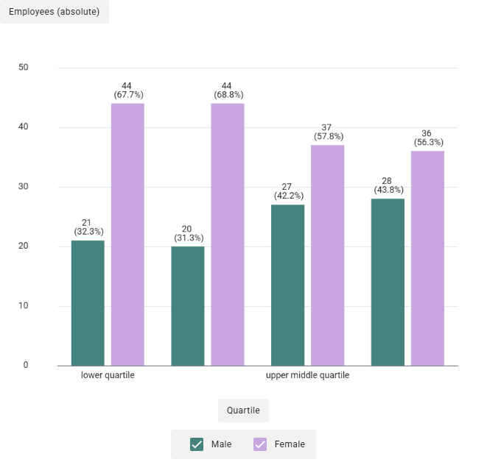
Headcount by quartile
Our quartile information shows that there are proportionally more women than men in our lower middle quartiles. This is due to most of our business support and secretarial roles being occupied by women.
Over all our head count as a firm has a higher percentage of women.

Slide 4
Pay Gap
The table below shows our mean and median pay gap (between male and female employees) as at the selected snapshot date of 5 April 2024 - 2025.
Our analysis for 2026 shows a mean and median gender pay gap of 10.1% and 9.5% respectively with the removal of part-time secretarial staff, and 13.6% and 26.3% with all staff included.
Our gender pay gap is primarily caused by the structure of the workforce and the gender split across different roles within the organisation. As the mean and median figures are calculated across the whole organisation, this inevitably produces a gender pay gap that is wider as high-earning outliers are predominantly male and women are more prevalent in the business services, administrative and secretarial roles.
The gender pay gap report only looks at employees and does not include partner pay. This means that whilst partner pay is excluded, executive pay is included and although our upper quartile contains more women than men (56.3% female to 43.8% male), this does not reflect the balance at the most senior level.
Pay Gap
Gender Pay Gap | Mean | Median
 | 13.6% | 26.3%
Pay Gap (with the removal of the lower quartile outliers)
Gender Pay Gap | Mean | Median
 | 10.1% | 9.5%

Slide 5
Pay Gap for Fee Earners at same level
This level of pay gap does not exist when we analyse the data for our staff doing the same job at similar levels.
Gender Pay Gap Associates | Mean | Median
 | -5.2% | -4.28%
Gender Pay Gap Senior Associates | Mean | Median
 | -4.28% | -3.6%
As of the snapshot date, 63% of the associate group were women and 37% were men. 54% of the senior associate group were women and 46% were men. Any pay gap within these groups is typically caused by the distribution of men and women by level of qualification.

Slide 6
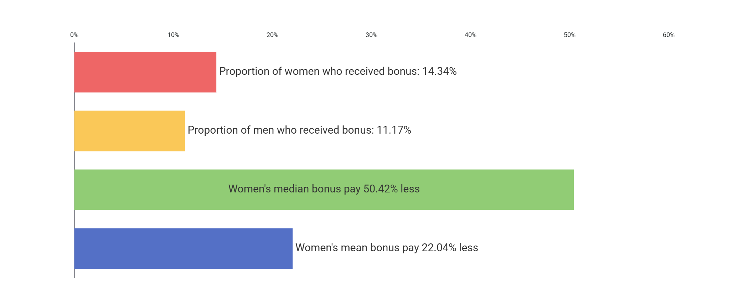
Bonus Gap
The bonus gap looks at bonuses paid during the 12-month period preceding the snapshot date.
Our mean bonus gap for this reporting period was mean 22.0% lower and the median was 50.4% lower. This gap is driven by a small number of the highest bonus roles being occupied by men (executive level) and the lowest bonus figures received by secretarial staff who are predominantly women.
As female representation at executive and senior leadership levels increases and a change made to the bonus scheme, we anticipate that this gap will continue to lessen. Our ongoing focus on succession planning and inclusive practices is intended to support a continued reduction in the gap.
For part‑time employees, the threshold is proportionately adjusted to reflect their working hours.

Slide 7
Key Trends at Fladgate:
Our gender pay and bonus figures show sustained and meaningful improvement over the past six years. We have reduced our mean gender pay gap from 22.9% to 13.6%, and our mean bonus gap has nearly halved since 2019. These trends reflect the increasing representation of women in senior and bonus‑earning roles, supported by our continued investment in leadership development, career progression pathways, and inclusive recruitment practices. While we recognise that there is more to do, the positive trajectory of these results demonstrates that our long‑term strategy is working and is delivering positive change across the firm.
Gender Pay Gap | Mean | Median
2019 | 22.9% | 39.2%
2020 | 24.5% | 36.3%
2021 | 17.5% | 36.8%
2022 | 23.7% | 25.9%
2023 | 16.9% | 8.2%
2024 | 16.5% | 25%
2025 | 13. 6% | 26.3%
Gender Bonus Gap | Mean | Median
2019 | 48.4% | 62.4%
2020 | 56.1% | 60.0%
2021 | 21.1% | 33.5%
2022 | 43.1% | 13.8%
2023 | 36.6% | 22.5%
2024 | 37.3% | -20.8%
2025 | 22.04% | 50.4%

Slide 8
What we have achieved
We continue to utilise our new gender pay gap platform to enable us to analyse our data at a far more granular level. This has strengthened our understanding of the key contributing factors to our gender pay gap and highlighted where targeted action can have the greatest impact.
During the reporting period, we appointed two women to the Executive Board and Senior Management, demonstrating our commitment to diverse leadership.
We will continue to build a diverse leadership team and ensure strong gender representation within the partnership and future pipelines. We will closely manage our talent pipeline for all fee‑earners and complete talent mapping for business teams to support more women into management roles.
We will continue partnering with our Heads of Department to monitor progress against targets and KPIs across all aspects of Inclusion & Diversity. Our HoDs, HR Managers and Director of People & Culture will jointly review all promotions and retention issues to identify and mitigate any areas of bias.
We have enhanced our collaboration with recruitment partners to ensure we attract and identify diverse talent at all levels, including partnership candidates.
Leadership: increasing diversity at leadership level and equipping leaders to be inclusive through training and coaching.
Recruitment and retention: strengthening diversity across the firm.
Employee experience and progression: ensuring fairness and consistency across all people processes.
Culture: embedding an inclusive culture and driving meaningful behavioural change.
Wellbeing: supporting a motivated, healthy workforce.
Networks: fostering collaboration through employee‑led networks.
As part of our new I&D Strategy, we focused on six priority areas:

Slide 9
A key part of this was enhancing our learning and development approach. This included coaching for individuals aspiring to partnership, re‑introducing performance reviews, new Associate and Senior Associate development programmes, and a competency frameworks for fee earners.
We also expanded development opportunities across business teams, including management training, to ensure consistency and equity in progression. While introduced upwards mentoring to strengthen inclusive leadership capability and foster collaboration throughout the firm.
We have implemented an enhanced family policy and will continue to assess the impact of flexible and hybrid working on career progression, ensuring policies enable both men and women to balance work and personal responsibilities without disadvantage.
These actions, combined with a continued focus on data and accountability, will help drive sustainable improvements in gender equity and broader diversity outcomes across the firm.
We confirm the data reported is accurate and has been calculated according to legal requirements.
Claire Cherrington Director of People and Culture | Helen Curtis-Goulding Partner I&D Lead

